Slide 1
Final Project
Janessa Rangel
¾ A

Slide 2
Description of Game
Welcome to a game filled with action and adventure! On a quest through the jungle, players must pass and complete challenging tasks in order to get to the next level. Sometimes, players must work together. The goal is to complete the game and ultimately, win. This requires diligence and determination. Good Luck!

Slide 3
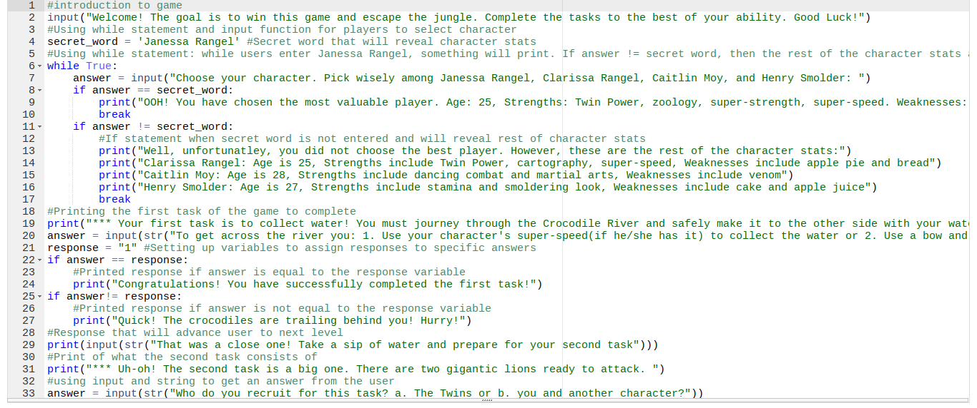
Demonstration of Game

Slide 4
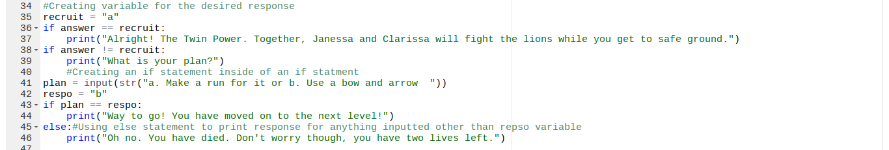
If statements and variables

Slide 5
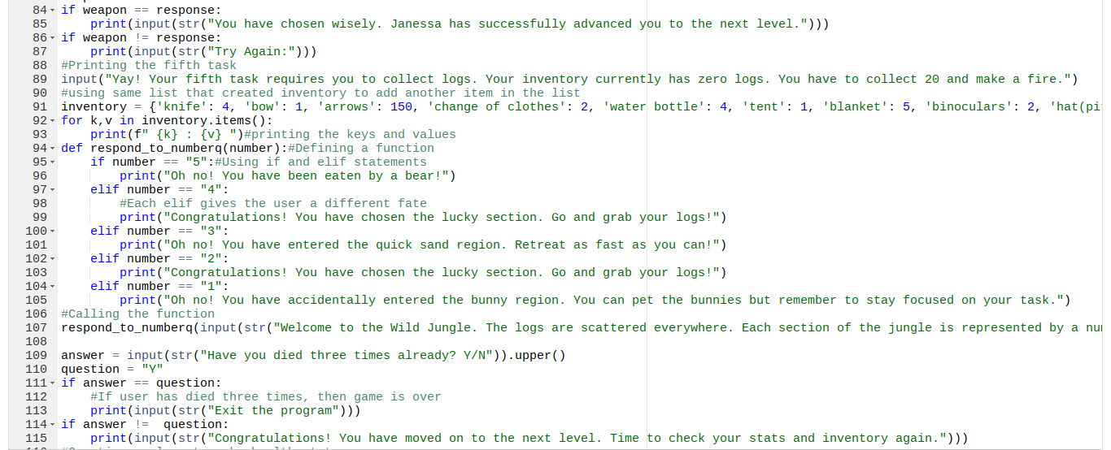
Elif/if statements and lists:

Slide 6
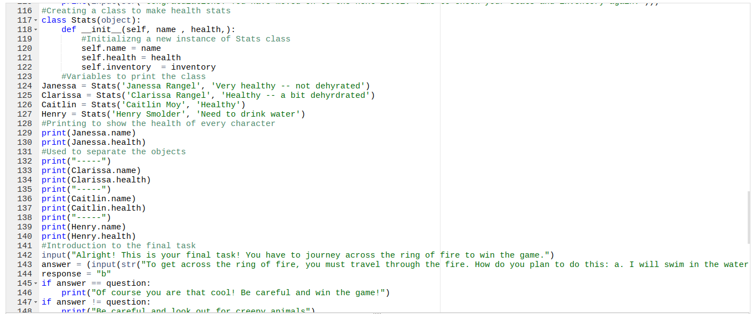
Classes

Slide 7
Favorite Feature

Slide 8
Things I figured out/didn’t remember
If/Elif Statements
For/While Loops
Printing keys and values in a list/dictionary
Referred back to old exercises
Played around with the code before asking for help

Slide 9
Are there any questions?

